Slide 1
KARNATAKA TOUR & TRAVEL MANAGEMENT
Under The Guidance Of :
Prof . Partha Sarathy P.V
USING PHP
Presented by:
SHAILENDRA S 1AM21CS169
SHARATH KUMAR R 1AM21CS170

Slide 2
Agenda
Introduction
Objectives
Technology Used
Features and Modules
Screen shorts
Conclusion

Slide 3
INTRODUCTION
The Karnataka Tour & Travel Management System is a dynamic web application developed to simplify and enhance the travel experience for users exploring Karnataka. Designed with PHP, this system provides a user-friendly platform for tourists to find, book, and manage travel packages, while offering robust administrative tools for travel operators to manage their services effectively.

Slide 4
OBJECTIVES
Enhance the efficiency of booking and managing travel services for users and administrators.
Provide a visually appealing and easy-to-use platform for tourists to explore and book travel packages.
Offer powerful tools for administrators to oversee and optimize travel services and bookings.
Design the system to accommodate future enhancements and increasing user demand.

Slide 5
TECHNOLOGY USED
PHP:Server-side scripting language for handling dynamic content and interactions with the database.
MySQL:Database system for storing and managing user data, travel packages, and bookings.
HTML:Markup language for structuring web content and forms.
CSS:Styling language for designing and laying out web pages.
JavaScript:Adds interactivity and dynamic features to web pages, including form validation
Bootstrap:Front-end framework for responsive design and pre-built UI components.

Slide 6
FEATURES AND MODELS
User Features:
1.Registration and Login:
Registration: Users provide personal details (name, email, password) to create an account.
Login: Users enter credentials to access their accounts.
Password Management: Includes functionality for changing passwords and recovering forgotten password
2. Package Browsing:
Function: Enables users to explore and view travel packages
Package Details: Each package includes descriptions, images, itineraries, and pricing information
3. Booking Management:
Booking Confirmation: Users receive confirmation of their booking via email or on the platform
Booking History: Users can view and manage their past and upcoming bookings

Slide 7
Admin Features:
Package Management:
Function: Allows administrators to manage travel packages offered on the platform.
Create and Update Packages: Admins can add new packages, modify existing ones, and set prices and availability.
Delete Packages: Remove packages that are no longer available or relevant.
Package Details Management: Includes managing descriptions, images, itineraries, and other package attributes
2. Booking Management:
View Bookings: Access a comprehensive list of all bookings made by users.
Manage Bookings: Includes confirming, canceling, or modifying bookings as needed.
3. Reporting and Analytics:
Generate Reports: Create reports on booking statistics, package popularity, and user engagement
4. User Management:
View Users: Access user profiles and manage user accounts.
Manage Access: Control user permissions and handle account issues.
Maintenance: Perform routine maintenance tasks to ensure the smooth operation of the system.

Slide 8
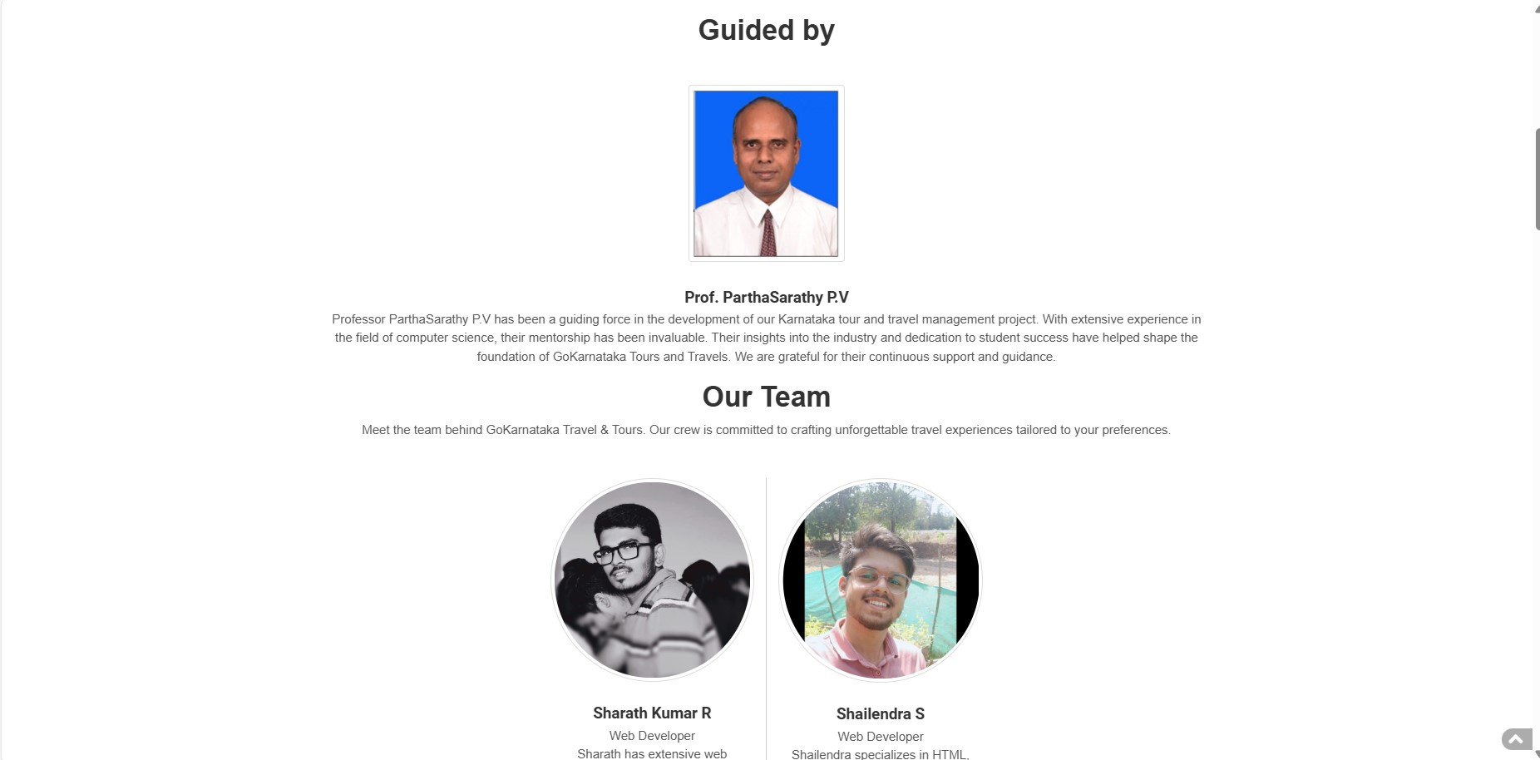
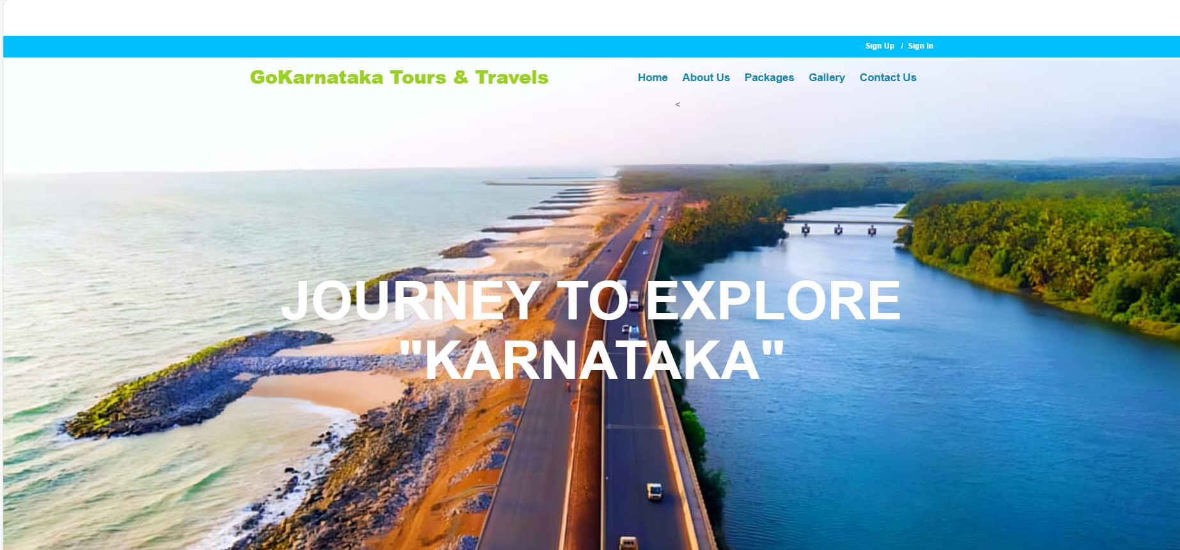
SCREENSHORTS

Slide 9
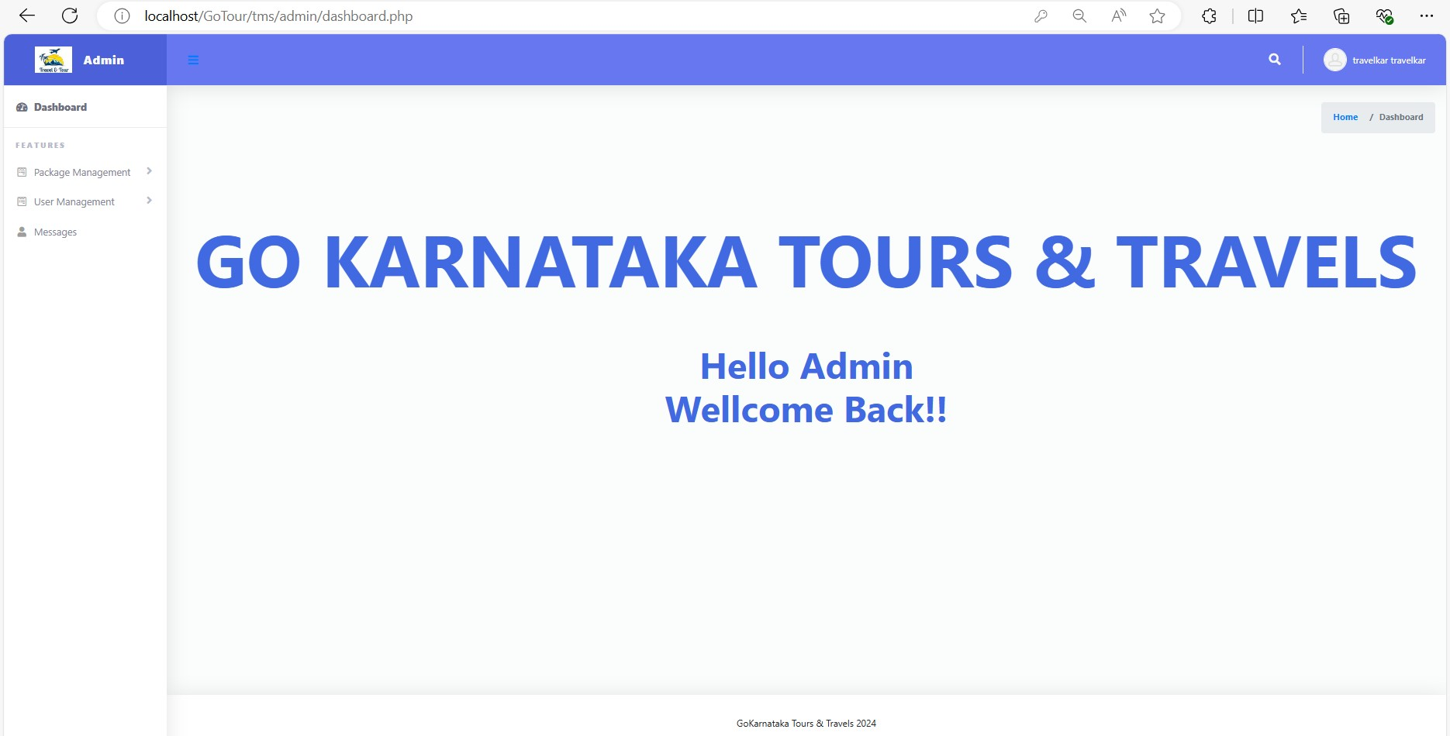
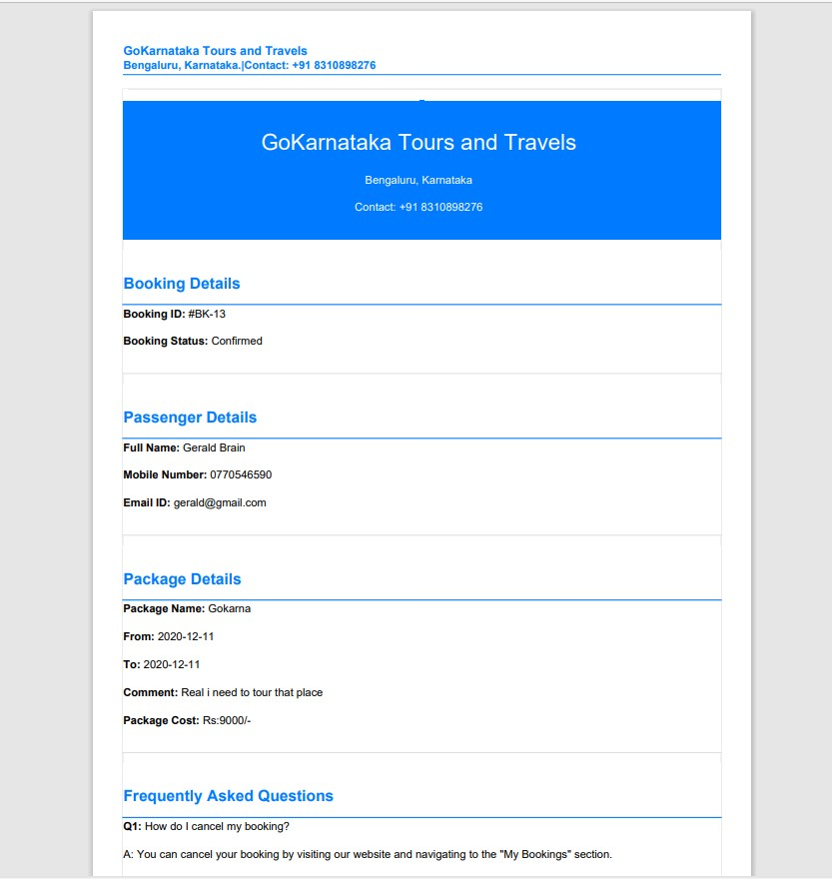

Slide 10
CONCLUSION
The Karnataka Tour & Travel Management System is designed to streamline and enhance the travel experience for users by providing a comprehensive platform for browsing, booking, and managing travel packages. It offers a user-friendly interface for tourists to explore and book travel options and robust administrative tools for managing packages, bookings, and user interactions efficiently.

Slide 11
THANK YOU!
Presented by:
SHAILENDRA S 1AM21CS169
SHARATH KUMAR R 1AM21CS170

